Slide 1
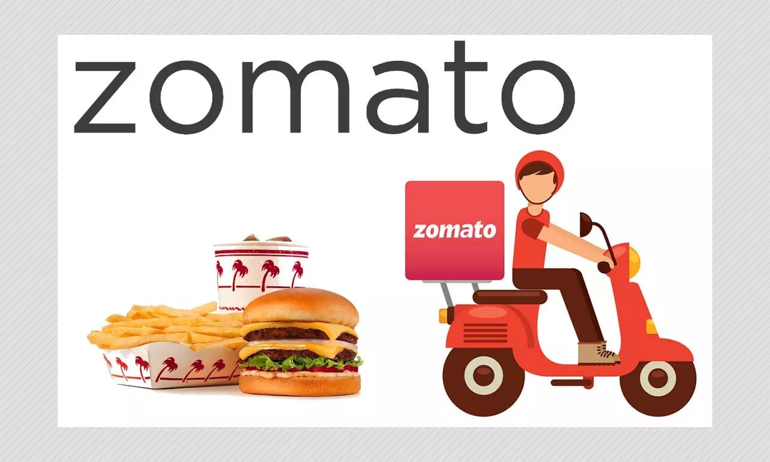
Zomato analysis Group 2 Krushnapriya Rakshitha Shravani Shwet Kamal

Slide 2
Objective
The Zomato analysis project analyzed the growth of restaurants over several years based on a dataset containing 9.5k rows
Data cleaning and analysis: Excel and MySQL were used to clean the data, Perform analysis, and remove duplicates from the data sets.
Dashboard creation: Tableau and Power BI were employed to create interactive dashboards. These tools facilitated calculations, merging of datasets, and visualization of key metrics related to restaurant growth
overall, the project aimed to provide insights into Zomato Analysis and track its growth over time through the creation of a visually appealing and informative dashboard

Slide 3
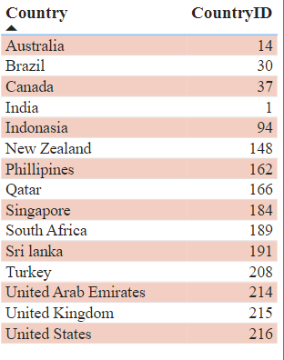
KPI 1
The given country Map Table shows the,
Country Name and Country ID.

Slide 4
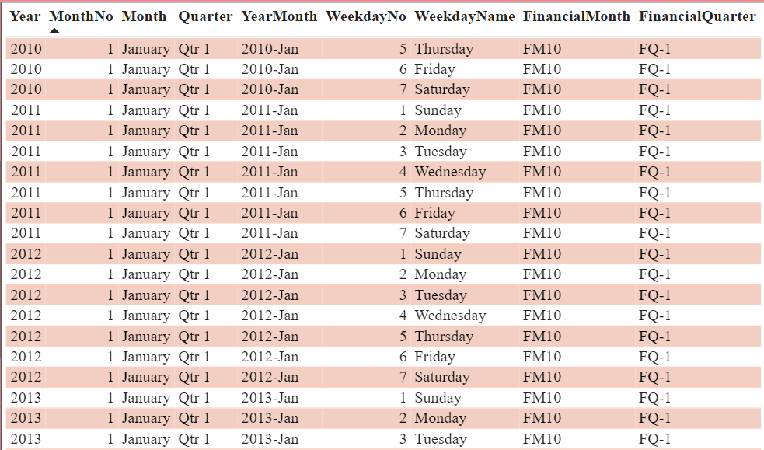
KPI 2
Table columns for the date key include year, month number and name, quarter, year-month, weekday, and financial period.

Slide 5
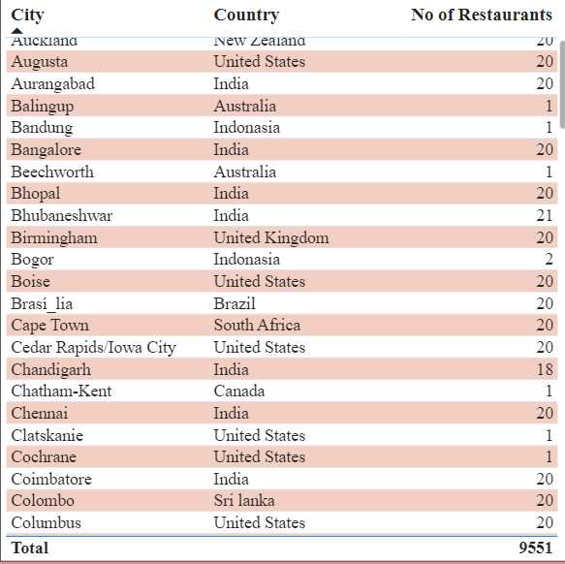
KPI 3
The table displays the number of restaurants in each city and country, a total of 9551 restaurants.

Slide 6
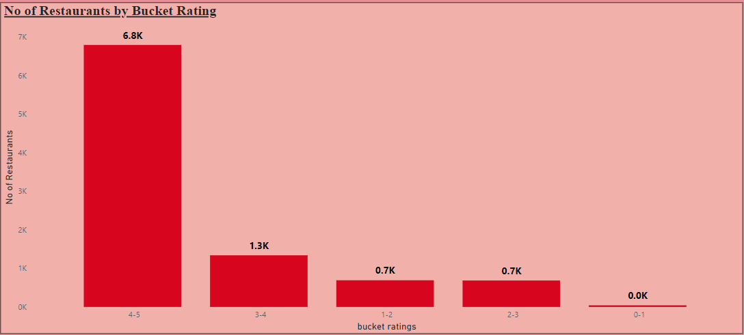
KPI 4
The Number of restaurants by bucket ratings
We found some information about the Bucket rating system. According to sources, currently,
6790 restaurants have been rated with a score of 4-5.
1338 restaurants have been rated with a score of 3-4.
691 restaurants have been rated with a score of 1-2.
685 restaurants have been rated with a score of 2-3 and
42 restaurants have been rated with a score of 0-1 on the Bucket rating system.

Slide 7
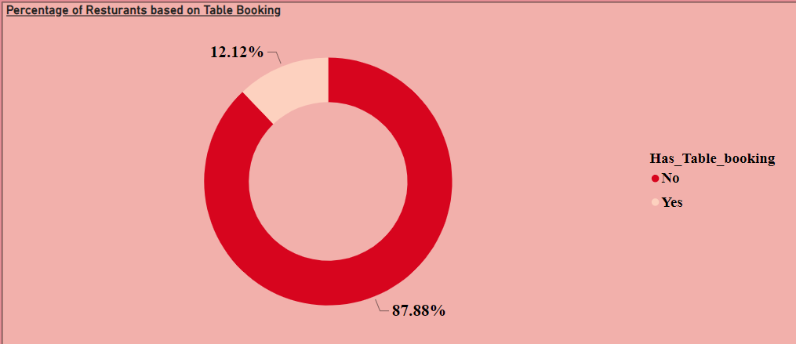
KPI 5
The percentage of restaurants based on Table Booking.
After analyzing the donut chart, we found that out of the total bookings, only 12.12% were table bookings, while the remaining 87.88% had no table bookings.
This indicates that restaurants not providing table booking constitute a larger portion compared to restaurants providing table booking.

Slide 8

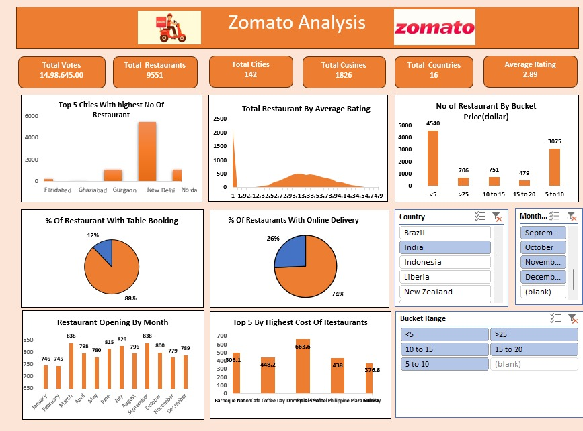

Slide 9
Conclusion Based on the analysis provided, it seems that Indian cuisine is quite popular on the Zomato platform, with a significant number of restaurants offering North Indian and Mughlai cuisines. Additionally, the majority of restaurants have an average rating between 3.1 and 3.5, indicating a generally satisfactory level of customer satisfaction. The cuisine cost is around $10, suggesting that dining at these establishments is relatively affordable. It's interesting to note that a quarter of the restaurants offer online delivery services, indicating a trend toward convenience for customers. With around 1000 new restaurants opening each year, there appears to be a dynamic and growing restaurant scene. Delhi seems to be a hotspot for restaurant openings, with around 5k restaurants operating in the city. Overall, India has a diverse culinary landscape, with a wide range of cuisines available to customers. This diversity is perhaps unmatched by any other country, including the USA.

Slide 10
THANK YOU

